Slide 1




Slide 2
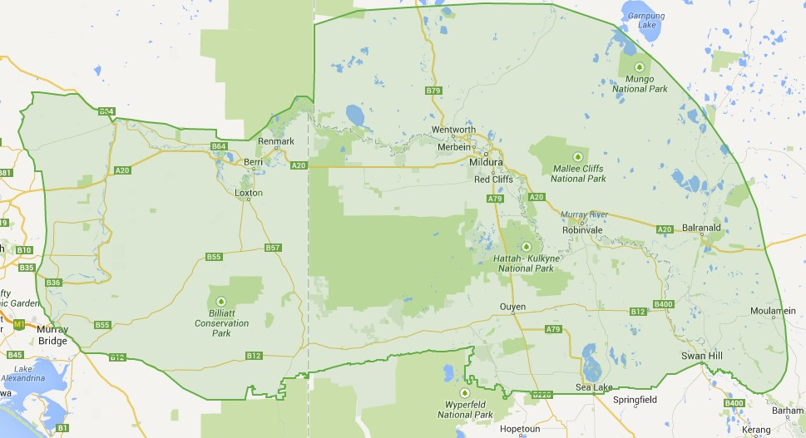
Issues
Growers need to adopt IWM strategies for Brome Grass to ensure long term viability
Farmers understanding sandy soils better, and implement profitable crop sequences to enhance the productivity and environmental sustainability of Mallee sandy soils

Slide 3
Extension messages
Integrated Weed Management
Integrated Sandy Soil Management

Slide 4




Extension approaches -Partnerships

Slide 5
Extension approaches
Field Days
Workshops
Communication / information sharing
Fact sheets
Farmer Case studies
Research compendium

Slide 6
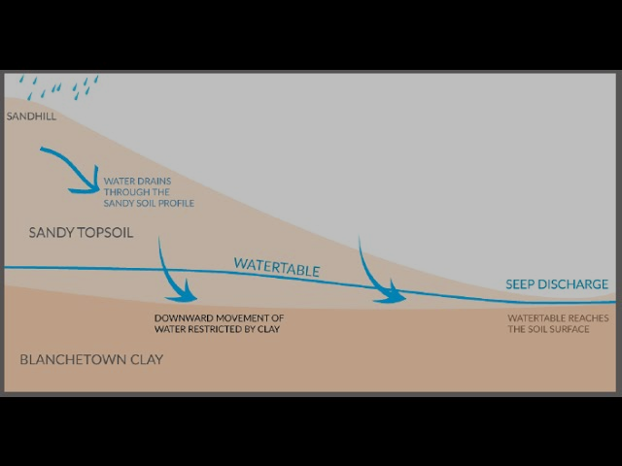
Successes and Improvements -Adaptability

Slide 7
Seeps on property
Notes:
Some of the responses indicated that although they didn’t have seeps on property, they wanted more information to provide their clients or to be better aware of potential seeps on their property in the future.

Slide 8
Prior and After Session Knowledge Comparison
Notes:
For each session, estimated knowledge after the session was greater than prior knowledge.
The greatest knowledge increase was within the presentation given by James Hall

Slide 9
Likelihood of change
“incorporate organic matter and clay”
“be more aware of soaks and address the problem before it gets too bad”
“actively recommend spading and arrange contracting”
“chicken manure spreading and incorporation”
Notes:
Likelihood of change after the event, in terms of both incorporating new information from the sessions and making decisions based on the information given, was above 4.1/5

