Slide 1
Notes:
Opening
15 minute presentation
Problem, Capabilities, Value proposition
Q & A at the end
Brand concept
Drive Cultural change, demonstrate performance

Slide 4
Current Performance

Slide 5
Current Performance
17% of workplace deaths in Australia occur on farming properties.
3% of Australia’s workforce is farm based.

Slide 6
Safework SA 7 Steps

Slide 7
Capabilities
Site Induction
On Farm
Free WHS tools
Site maps
Notes:
Ag Induction Manager as part of the solution. It has these four key elements.
Up and running – no need to wait
Developed in consultation with industry and regulators
Clear language, easy navigation

Slide 8
Traditional Induction Approach
Induction 1
Induction 2
Induction 3
Induction 4
Induction 5
Company A
Company B
Company C
Company D
Company E
Visitor
Visitor
Visitor
Visitor
Visitor
Grower / Carrier
Grower / Carrier
Grower / Carrier
Grower / Carrier
Grower / Carrier
Casual Employee
Casual Employee
Casual Employee
Casual Employee
Casual Employee
Permanent Employee
Permanent Employee
Permanent Employee
Permanent Employee
Permanent Employee
Notes:
Traditionally, inductions are specific to a single company
An individual may have to do many inductions, covering the same material

Slide 9
Ag Induction Manager
Core
Content
Core
Worker
Type
Farm Grower / Carrier
Site Employee / Contractor
Industry
Modules
On Farm
Grain
Fertiliser
Hay
Horticulture
Grain
Fertiliser
Hay
Horticulture
Company
Modules
Company A
Company B
Balco
Company A
Company C
Notes:
Ag Induction Manager is a unique platform
Based on subscription
Access to any inductions in the system
Workers self-select those inductions
Example
Seasonal Worker
- Grain harvest, on to fruit picking, then on to grain receival

Slide 10
Seasonal Worker Working on farm for grain harvest
Core
Content
Core
Worker
Type
Farm Grower / Carrier
Site Employee / Contractor
Industry
Modules
On Farm
Grain
Fertiliser
Hay
Horticulture
Grain
Fertiliser
Hay
Horticulture
Company
Modules
Company A
Company B
Balco
Company A
Company C
Notes:
Example
Seasonal Worker
- Grain harvest, on to fruit picking at a corporate farm, then on to a grain receival site

Slide 11
Seasonal Worker Moves to fruit picking at a corporate farm
Core
Content
Core
Worker
Type
Farm Grower / Carrier
Site Employee / Contractor
Industry
Modules
On Farm
Grain
Fertiliser
Hay
Horticulture
Grain
Fertiliser
Hay
Horticulture
Company
Modules
Company A
Company B
Balco
Company A
Company C
Notes:
Example
Seasonal Worker
- Grain harvest, on to fruit picking at a corporate farm, then on to a grain receival site

Slide 12
Seasonal Worker Moves to work at a grain receival site
Total Cost
$49 + GST
Core
Content
Core
Worker
Type
Farm Grower / Carrier
Site Employee / Contractor
Industry
Modules
On Farm
Grain
Fertiliser
Hay
Horticulture
Grain
Fertiliser
Hay
Horticulture
Company
Modules
Company A
Company B
Balco
Company A
Company C
Notes:
Ag Induction Manager is a unique platform
Based on subscription
Access to any inductions in the system
Workers self-select those inductions that are relevant to them and can add throughout their subscription at no additional cost.
Example
Seasonal Worker
- Grain harvest, on to fruit picking at a corporate farm, then on to a grain receival site

Slide 13
Opportunity for Single Standard

Slide 15
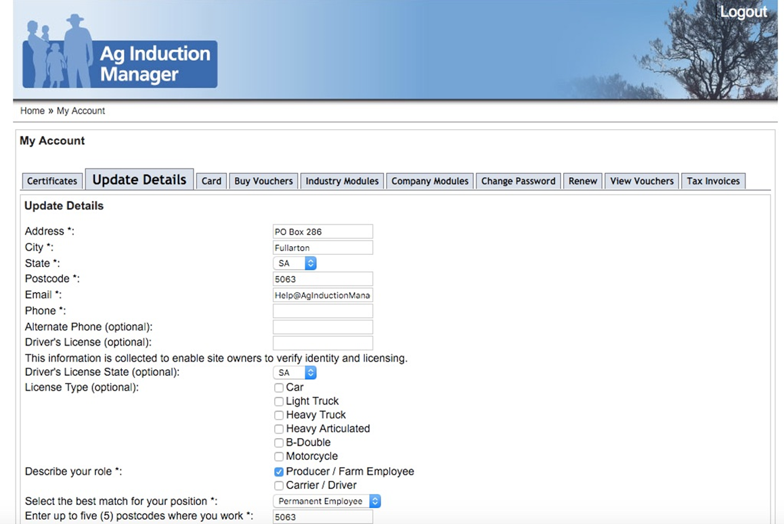

Slide 16
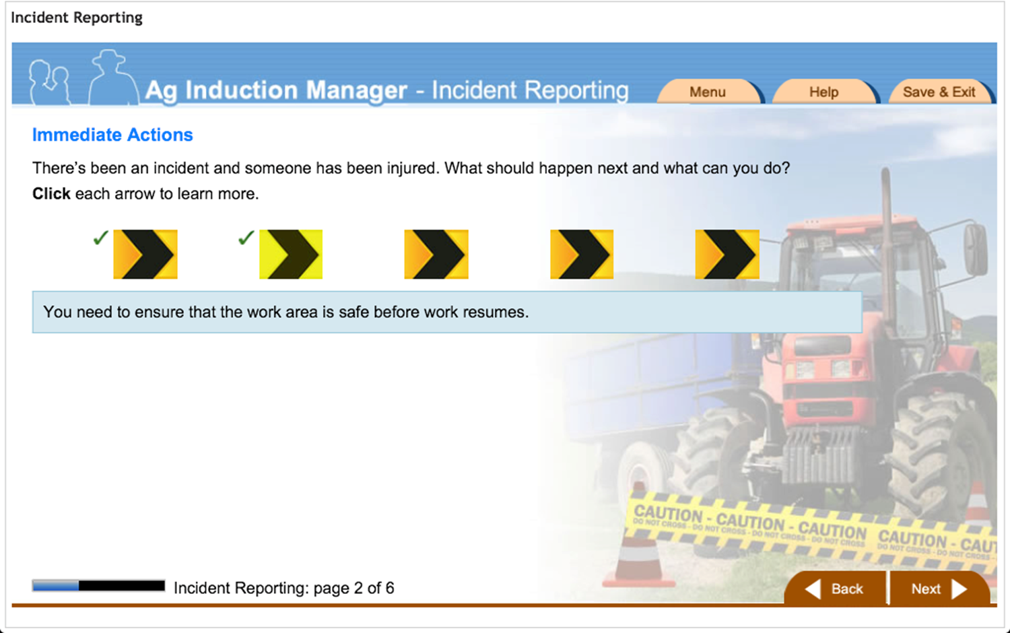

Slide 18
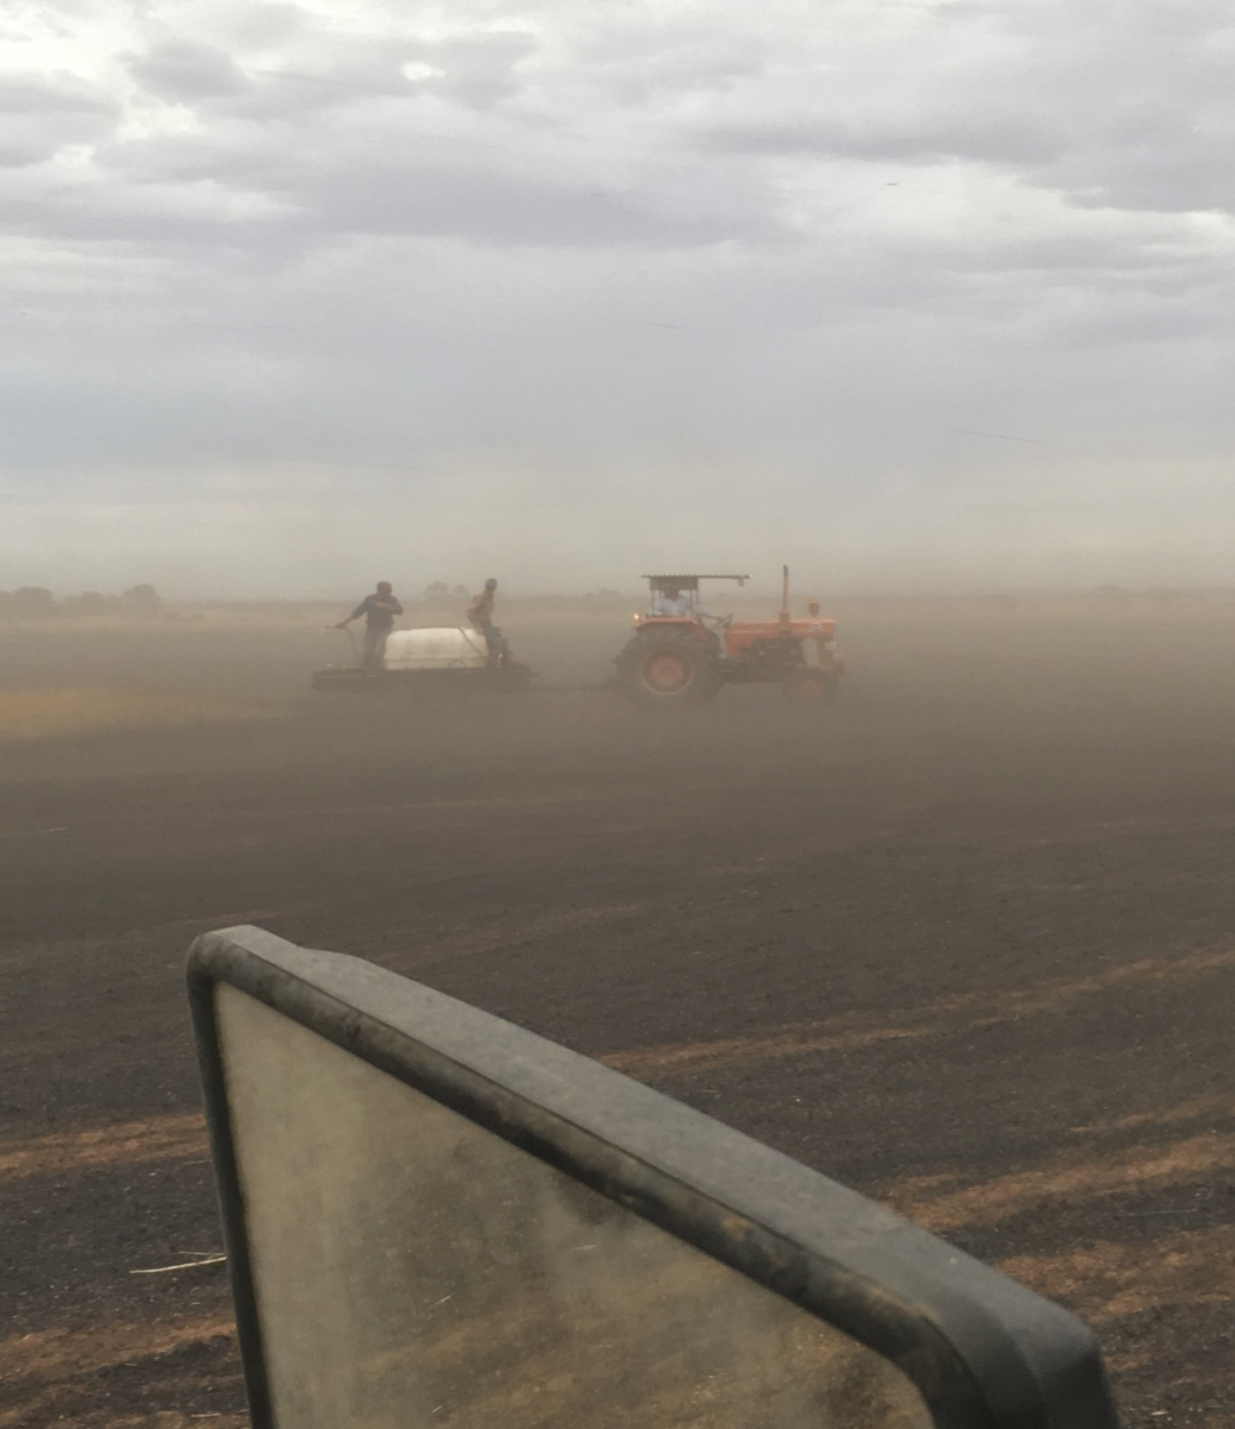
Industry Challenges

Slide 19
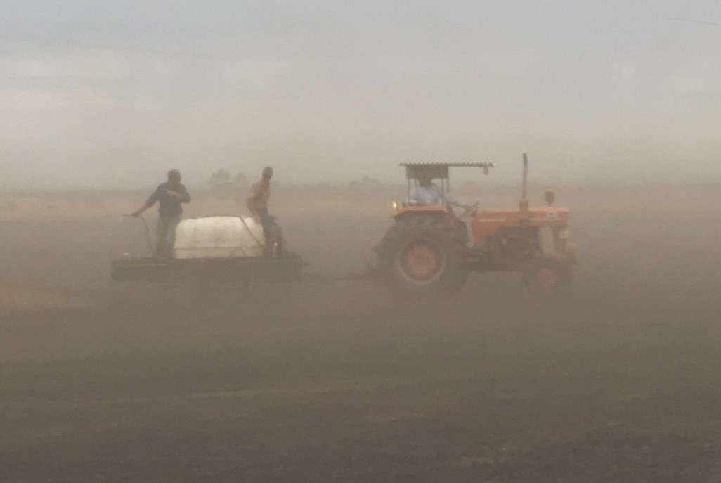
Industry Challenges

Slide 20
Industry Challenges
Who is the Industry custodian for our reputation??

Slide 21
Involved or Committed??

Slide 22
2007 HIA policy statement
“…that HIA take a leadership role for improved safety in the residential building industry, including adopting a proactive approach in developing and showcasing practical solutions.”

Slide 23
NSW Farmers 12-13 Policy Document
“That the association thoroughly investigate the possibility of uniting with other likeminded organizations in order to force changes to current workcover legislation so that visitors/employees/contractors will have to accept responsibility for their own actions”

Slide 24
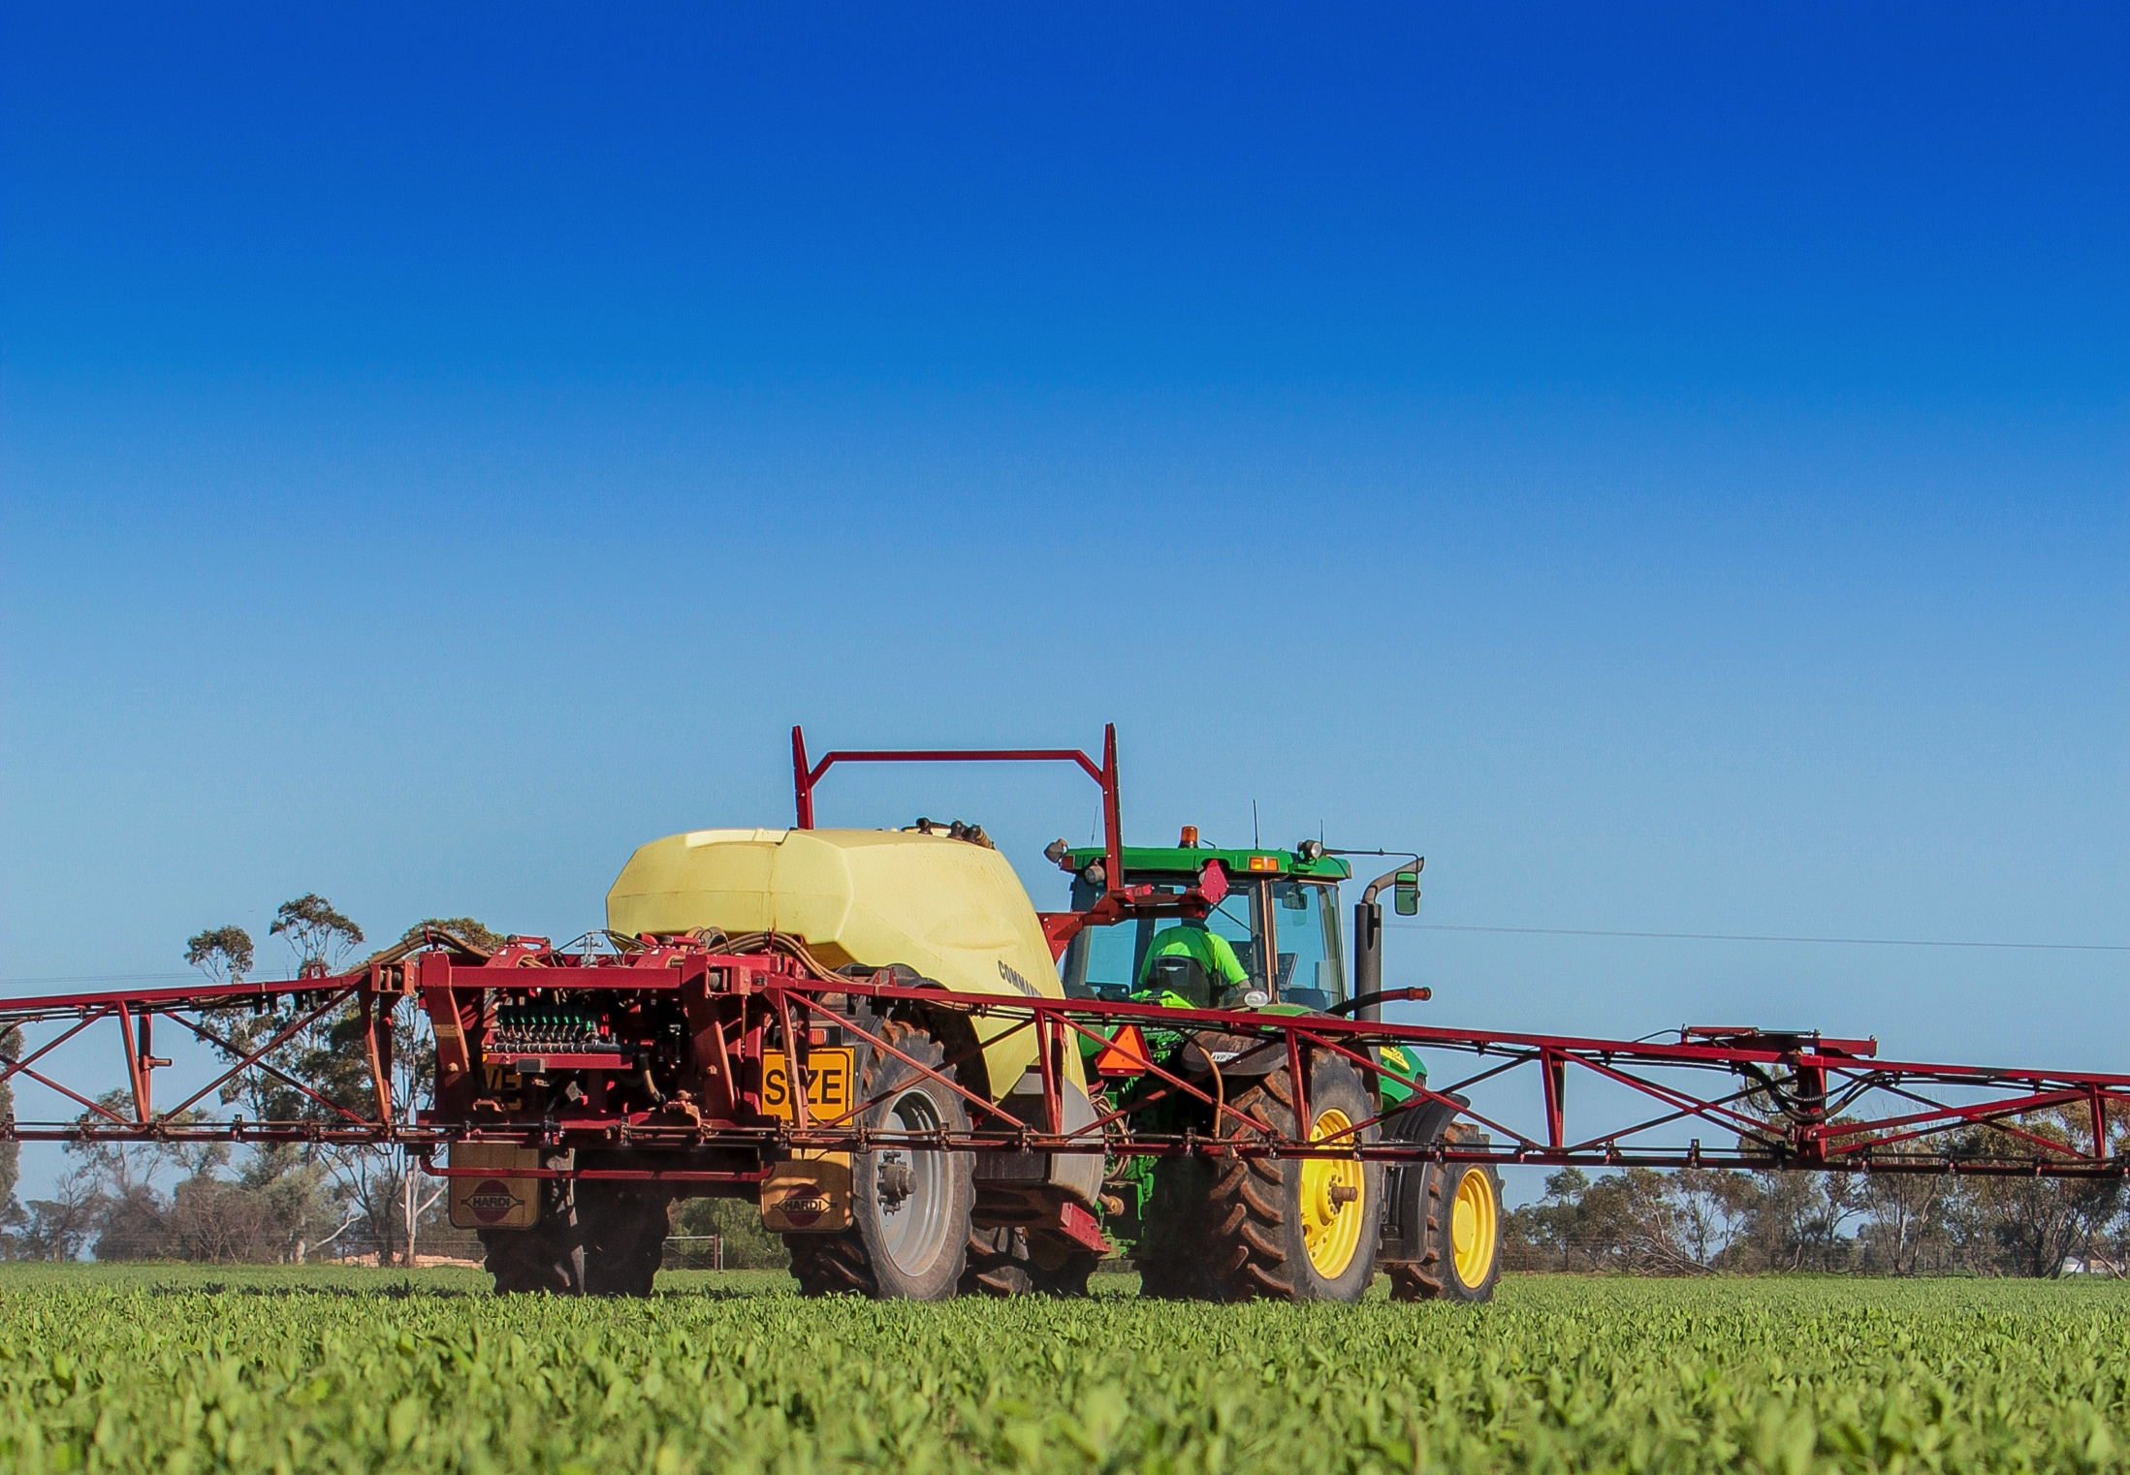
Industry Opportunities
Standing Industry Agenda Item
Notes:
Workers
One payment, one platform
Unlimited inductions
Do it in own time, own place - no need to travel to central location.
Transferrable across different employers
Farm Managers
Farm employees & family members
Contractors
Farm manager education
Free tools
Recordable
Site Operators
Induction for people picking up or delivering goods – prior to entering site
Common Industry content
Ability to add company specific information
Recordable & auditable
Can be used for employees & contractors
Ability to show they are pushing safety through the supply chain
Branding opportunity
Wider Industry
Lift industry standard
Cost effective
Single Platform
Standard work practices
Supply chain solution to worker safety
Industry-wide positive branding opportunity
Could turn Australia into a global leader

Slide 25
Industry Opportunities
Standing Industry Agenda Item
Industry Notifications
Notes:
Workers
One payment, one platform
Unlimited inductions
Do it in own time, own place - no need to travel to central location.
Transferrable across different employers
Farm Managers
Farm employees & family members
Contractors
Farm manager education
Free tools
Recordable
Site Operators
Induction for people picking up or delivering goods – prior to entering site
Common Industry content
Ability to add company specific information
Recordable & auditable
Can be used for employees & contractors
Ability to show they are pushing safety through the supply chain
Branding opportunity
Wider Industry
Lift industry standard
Cost effective
Single Platform
Standard work practices
Supply chain solution to worker safety
Industry-wide positive branding opportunity
Could turn Australia into a global leader

Slide 26
Industry Opportunities
Standing Industry Agenda Item
Industry Notifications
Commodity Collaboration
Notes:
Workers
One payment, one platform
Unlimited inductions
Do it in own time, own place - no need to travel to central location.
Transferrable across different employers
Farm Managers
Farm employees & family members
Contractors
Farm manager education
Free tools
Recordable
Site Operators
Induction for people picking up or delivering goods – prior to entering site
Common Industry content
Ability to add company specific information
Recordable & auditable
Can be used for employees & contractors
Ability to show they are pushing safety through the supply chain
Branding opportunity
Wider Industry
Lift industry standard
Cost effective
Single Platform
Standard work practices
Supply chain solution to worker safety
Industry-wide positive branding opportunity
Could turn Australia into a global leader

Slide 27
Industry Opportunities
Standing Industry Agenda Item
Industry Notifications
Commodity Collaboration
Look Outside Ag for Solutions
Notes:
Workers
One payment, one platform
Unlimited inductions
Do it in own time, own place - no need to travel to central location.
Transferrable across different employers
Farm Managers
Farm employees & family members
Contractors
Farm manager education
Free tools
Recordable
Site Operators
Induction for people picking up or delivering goods – prior to entering site
Common Industry content
Ability to add company specific information
Recordable & auditable
Can be used for employees & contractors
Ability to show they are pushing safety through the supply chain
Branding opportunity
Wider Industry
Lift industry standard
Cost effective
Single Platform
Standard work practices
Supply chain solution to worker safety
Industry-wide positive branding opportunity
Could turn Australia into a global leader

Slide 28
Industry Opportunities
Standing Industry Agenda Item
Industry Notifications
Commodity Collaboration
Look Outside Ag for Solutions
Develop WHS Policy
Notes:
Workers
One payment, one platform
Unlimited inductions
Do it in own time, own place - no need to travel to central location.
Transferrable across different employers
Farm Managers
Farm employees & family members
Contractors
Farm manager education
Free tools
Recordable
Site Operators
Induction for people picking up or delivering goods – prior to entering site
Common Industry content
Ability to add company specific information
Recordable & auditable
Can be used for employees & contractors
Ability to show they are pushing safety through the supply chain
Branding opportunity
Wider Industry
Lift industry standard
Cost effective
Single Platform
Standard work practices
Supply chain solution to worker safety
Industry-wide positive branding opportunity
Could turn Australia into a global leader

Slide 29
Industry Opportunities
Cloud Based Platform
Notes:
Workers
One payment, one platform
Unlimited inductions
Do it in own time, own place - no need to travel to central location.
Transferrable across different employers
Farm Managers
Farm employees & family members
Contractors
Farm manager education
Free tools
Recordable
Site Operators
Induction for people picking up or delivering goods – prior to entering site
Common Industry content
Ability to add company specific information
Recordable & auditable
Can be used for employees & contractors
Ability to show they are pushing safety through the supply chain
Branding opportunity
Wider Industry
Lift industry standard
Cost effective
Single Platform
Standard work practices
Supply chain solution to worker safety
Industry-wide positive branding opportunity
Could turn Australia into a global leader

Slide 30
Cloud Based Platform

Slide 31
Industry Opportunities
Cloud Based Platform
Accident Investigation
Notes:
Workers
One payment, one platform
Unlimited inductions
Do it in own time, own place - no need to travel to central location.
Transferrable across different employers
Farm Managers
Farm employees & family members
Contractors
Farm manager education
Free tools
Recordable
Site Operators
Induction for people picking up or delivering goods – prior to entering site
Common Industry content
Ability to add company specific information
Recordable & auditable
Can be used for employees & contractors
Ability to show they are pushing safety through the supply chain
Branding opportunity
Wider Industry
Lift industry standard
Cost effective
Single Platform
Standard work practices
Supply chain solution to worker safety
Industry-wide positive branding opportunity
Could turn Australia into a global leader

Slide 32
Industry Opportunities
Cloud Based Platform
Accident Investigation
Audit Process Control
Notes:
Workers
One payment, one platform
Unlimited inductions
Do it in own time, own place - no need to travel to central location.
Transferrable across different employers
Farm Managers
Farm employees & family members
Contractors
Farm manager education
Free tools
Recordable
Site Operators
Induction for people picking up or delivering goods – prior to entering site
Common Industry content
Ability to add company specific information
Recordable & auditable
Can be used for employees & contractors
Ability to show they are pushing safety through the supply chain
Branding opportunity
Wider Industry
Lift industry standard
Cost effective
Single Platform
Standard work practices
Supply chain solution to worker safety
Industry-wide positive branding opportunity
Could turn Australia into a global leader

Slide 33
Industry Opportunities
Cloud Based Platform
Accident Investigation
Audit Process Control
WHS Leadership/Control
Notes:
Workers
One payment, one platform
Unlimited inductions
Do it in own time, own place - no need to travel to central location.
Transferrable across different employers
Farm Managers
Farm employees & family members
Contractors
Farm manager education
Free tools
Recordable
Site Operators
Induction for people picking up or delivering goods – prior to entering site
Common Industry content
Ability to add company specific information
Recordable & auditable
Can be used for employees & contractors
Ability to show they are pushing safety through the supply chain
Branding opportunity
Wider Industry
Lift industry standard
Cost effective
Single Platform
Standard work practices
Supply chain solution to worker safety
Industry-wide positive branding opportunity
Could turn Australia into a global leader

Slide 34
Industry Opportunities
Cloud Based Platform
Accident Investigation
Audit Process Control
WHS Leadership/Control
Branding
Notes:
Workers
One payment, one platform
Unlimited inductions
Do it in own time, own place - no need to travel to central location.
Transferrable across different employers
Farm Managers
Farm employees & family members
Contractors
Farm manager education
Free tools
Recordable
Site Operators
Induction for people picking up or delivering goods – prior to entering site
Common Industry content
Ability to add company specific information
Recordable & auditable
Can be used for employees & contractors
Ability to show they are pushing safety through the supply chain
Branding opportunity
Wider Industry
Lift industry standard
Cost effective
Single Platform
Standard work practices
Supply chain solution to worker safety
Industry-wide positive branding opportunity
Could turn Australia into a global leader

Slide 35
SA Industry Opportunities
1.2m savings on Induction
Notes:
Workers
One payment, one platform
Unlimited inductions
Do it in own time, own place - no need to travel to central location.
Transferrable across different employers
Farm Managers
Farm employees & family members
Contractors
Farm manager education
Free tools
Recordable
Site Operators
Induction for people picking up or delivering goods – prior to entering site
Common Industry content
Ability to add company specific information
Recordable & auditable
Can be used for employees & contractors
Ability to show they are pushing safety through the supply chain
Branding opportunity
Wider Industry
Lift industry standard
Cost effective
Single Platform
Standard work practices
Supply chain solution to worker safety
Industry-wide positive branding opportunity
Could turn Australia into a global leader

Slide 36
SA Industry Opportunities
1.2m savings on Induction
8.8m savings electronic platform
Notes:
Workers
One payment, one platform
Unlimited inductions
Do it in own time, own place - no need to travel to central location.
Transferrable across different employers
Farm Managers
Farm employees & family members
Contractors
Farm manager education
Free tools
Recordable
Site Operators
Induction for people picking up or delivering goods – prior to entering site
Common Industry content
Ability to add company specific information
Recordable & auditable
Can be used for employees & contractors
Ability to show they are pushing safety through the supply chain
Branding opportunity
Wider Industry
Lift industry standard
Cost effective
Single Platform
Standard work practices
Supply chain solution to worker safety
Industry-wide positive branding opportunity
Could turn Australia into a global leader

Slide 37
Notes:
We think our products can compliment your Premium Food and Wine strategy
Agriculture has a serious issue with worker safety
We have a proven platform that can be implemented throughout the agriculture supply chain
Sustainable model that provides commercial solutions
Not reliant on grant funding
It is up and running today
What do we need to do together to start the cultural change?

