Slide 1
Demonstrating value to the industry; promoting environmentally sustainable
& profitable farm practices being trialled & extended by grower groups in the AMLR

Slide 2
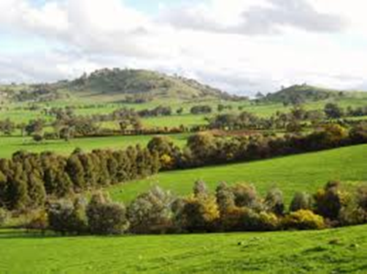
Outline
The AMLR NRM region
Sustainable primary production
2014-15 projects
IPM – the use of beneficial insects in
vegetable production on the Northern
Adelaide Plains.

Slide 3
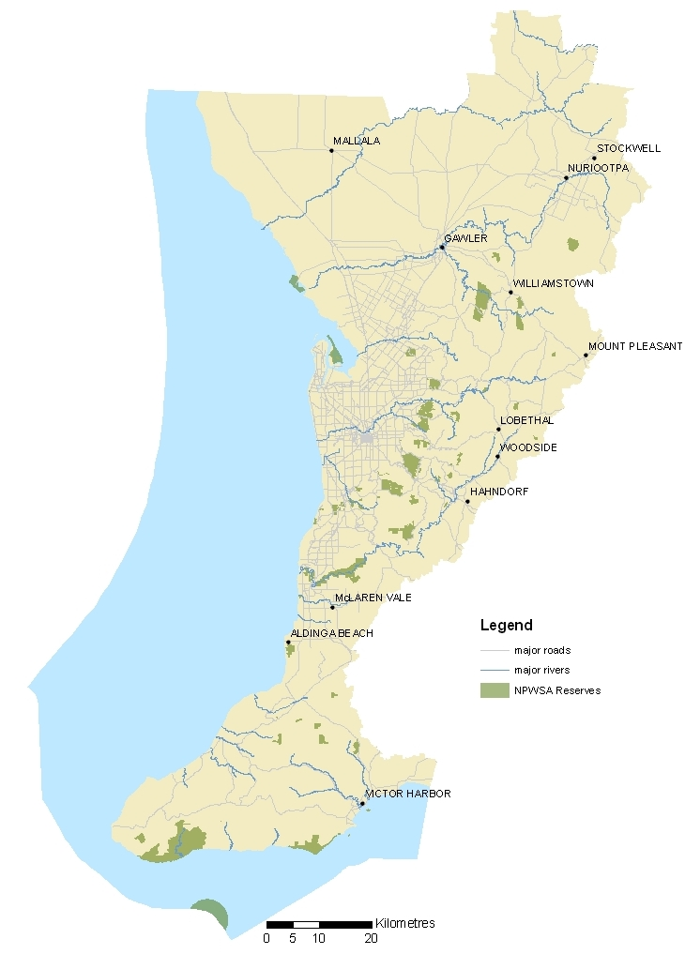
The region
Covers approximately 11,208 square kilometres.
About 59% is land – marine makes up the remaining 41%
Mix of ‘Rural lifestyle’ properties & commercial farmers
Diverse mosaic of landscape types
Most biologically diverse region in SA
Continual pressure from urban growth
Contains 1.2 million people – almost 80% of the State’s population.

Slide 4
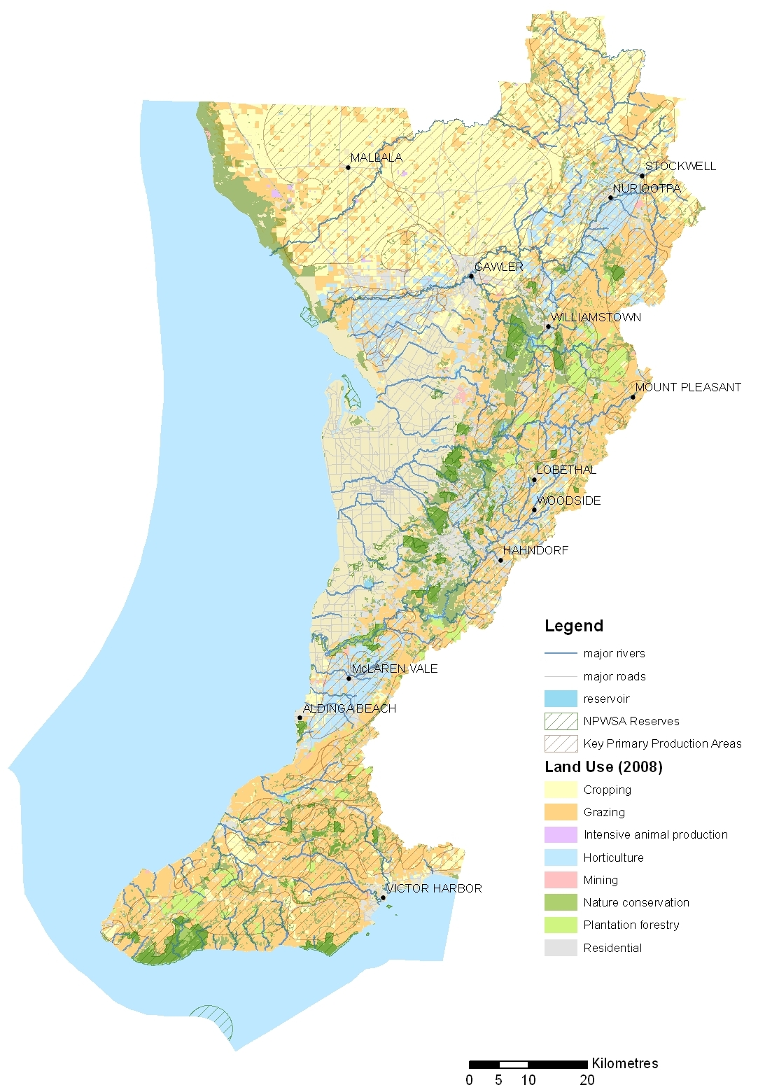
Primary Production in AMLR
Fruit & Nut trees: 1,407,312 ha
Sheep: 298,952 ha
Pigs: 84,736 ha
Cropping: 78,325 ha
Meat cattle: 65, 049 ha
Dairy cattle: 25,823 ha
Grapevines: 23,071ha
Horses: 2,753 ha
Vegetables: 2,347 ha

Slide 5
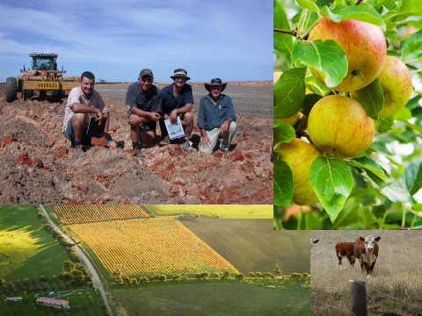
The Team
Jodie Pain & Nicole job-share Coordinator role.
Regional Landcare Facilitator – Lucy Hyde
3 x Sustainable Agriculture Officers – Taryn Mangelsdorf, Chris Nichols & Jeff Edwards

Slide 6
Sustainable Agriculture
2014-15 achievements
63 events attended by 1,144 participants on topics ranging from livestock and pasture management to soil health, weed and pest control, water use efficiency and post-fire recovery.
Landholders were also supported through the development of 181 new property plans.
Quarterly Small Talk,
monthly Regional Landcare
newsletter, monthly Events
Calendar and 3 case studies.

Slide 7
Industry Partnerships
In 2014−15, $270,000 supported nine industry projects:
Mallala, Stockport, Koonunga Ag Bureaux - improved soil health by addressing soil structure decline, sodicity and acidity.
Barossa Improved Grazing Group - recovery and management of native pastures after the 2014 Eden Valley bushfire.
Dairy SA - improved dairy effluent management through reducing, reusing and recycling wastes.
Dung Beetle Solutions Australia - dung beetles to promote sustainable cherry production.
HorseSA - horses and dung beetles; small farm management ideas.
Hortex - reduction in the impacts of pests on production, irrigation scheduling and cover cropping.
SA No-Till Famers Association – biochar and soil acidification.
Vietnamese Farmers Assoc - Waste Management Project.

Slide 8
The Benefits of Bugs
Integrated Pest Management project

Slide 9
Trialling the use of beneficial insects
Partnership with Hortex on the NAP
The problems:
high pest and virus pressure (Western Flower Thrips – also spreads tomato spotted wilt virus)
major losses in yield and quality
declining productivity
pesticide sprays expensive and time-consuming
widespread resistance to pesticides
occupational health and safety (OHS) issues.

Slide 10
Pesticide spraying is expensive, time-consuming, difficult in the confined space and often ineffective due to pesticide resistance in the area.
Frustrated and financially-stretched, many greenhouse growers were looking for a better way to manage pests and diseases.
Although recognising the need for a new approach, many growers were faced with an impossible situation.
With productivity so low they were unable to afford to change their practices.
Without change they were facing the prospect of abandoning the industry.

Slide 11
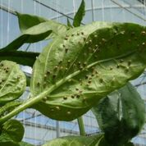
The Approach
A partnership was formed between the Adelaide and Mount Lofty Ranges Natural Resources Management (NRM) Board, Hortex and integrated pest management (IPM) service providers Biological Services and Manchil IPM.
The project aimed to build on the results of IPM trials conducted by Tony Burfield (formerly of the South Australian Research and Development Institute) and funded by the vegetable levy.

Slide 12
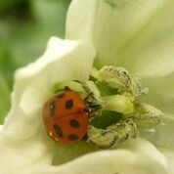
Funding from the board helped subsidise the costs of IPM for growers by 15 per cent. The cost ranged from $1.30 - $1.72/m² depending on the crop.
Initially 16 growers joined the project in 2012, which grew to 20 in early 2013, encompassing an area of approximately 25 hectares.
Growers were provided with an IPM program tailored to their production system which targeted four main pests using 11 species of beneficial insects.

Slide 13
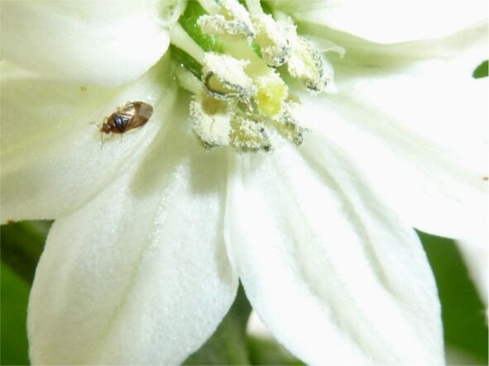
All IPM programs began in the nursery with healthy pest and virus-free seedlings free of pesticide residues.
Ideally, these were transplanted into a pest and virus-free greenhouse, modified with insect mesh to reduce entry by pests.
Sprays of compatible pesticides were sometimes needed to reduce the large numbers of thrips emerging after pupation in the soil. This gave the crop time to establish the canopy and flowers needed to support beneficial insects.

Slide 14
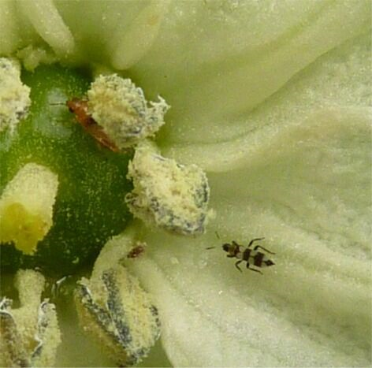
Growers were provided with a high level of technical support that included regular monitoring by trained personnel, twice weekly at first, then weekly once beneficial insects were established.
After each visit growers were given a written report outlining what was found and the actions to be taken.
“The main thing is continuing to learn from taking risks, assessing results and adapting with expert guidance and support,” (greenhouse vegetable growers, Emmanuel and Bill Cafcakis).

Slide 15
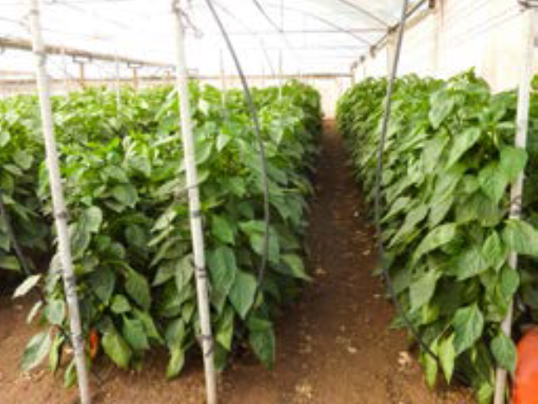
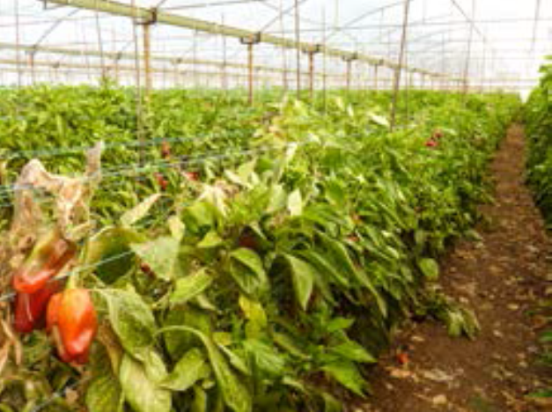
The Outcomes
IPM programs reduced damage by pests and viruses and increased the yield and quality of fruit.
Less sprays were needed which saved time and money and improved crop health.
The majority of growers reduced spraying from weekly (or more) to monthly.

Slide 16
The superior quality fruit and more consistent harvest resulting from IPM can give growers a marketing advantage through:
• reduced pesticide use by up to 85%
• effective control of pests
• lower virus incidence
• higher yields
• better quality fruit
• healthier plants
• longer harvesting period
• reduced pressure on pesticides
• less OHS concerns
• IPM becoming more affordable as uptake increases.

Slide 17
Farmer Hung Nguyen with James Altman and virus researcher Denis Persely in a crop grown successfully using IPM principles

Slide 18
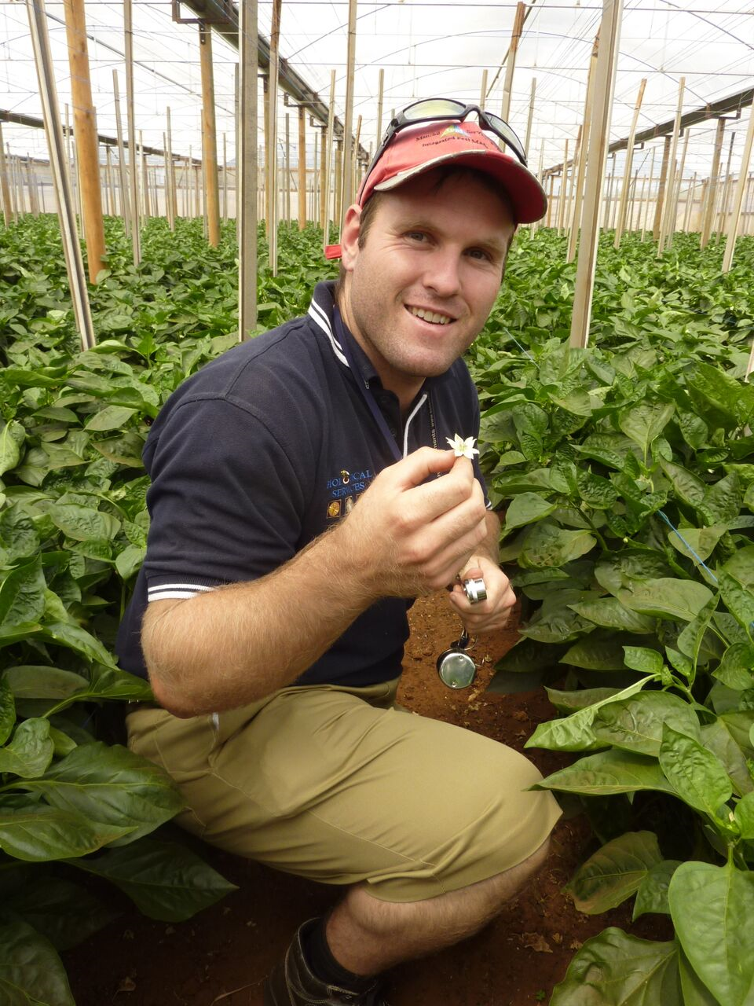
“As a result of implementing IPM we have
roughly doubled our sustainable production
levels compared to our low point when we
were trying to deal with pests and virus by
relying on pesticides alone”. Grower comment
Although initially expensive to set up,
over a whole season the cost of IPM
is more than justified compared to the
risk of crop failure.

Slide 19
Where to from here?
The success of IPM has sparked wider interest in the industry, with 35 growers now in the program.
Increasing adoption of IPM on the Adelaide Plains is bringing the costs of IPM down, making it potentially more accessible to an even greater number of growers.
The Sustainable Industry support scheme tapped into a desire for change in the greenhouse industry and helped growers see first-hand how and where improvements could be made.

Slide 20
Conclusion
“This funding helped us grow our business in the Adelaide Plains because growers could afford us,” said James Altmann, Managing Director of Biological Services.
The partnership between the board and industry provided the financial and technical support that growers needed to make a major change in production, improving productivity and paving the way for a more sustainable greenhouse industry.
Sustainable industry partnerships are funded through the Australian Government and managed by the board.

Slide 21
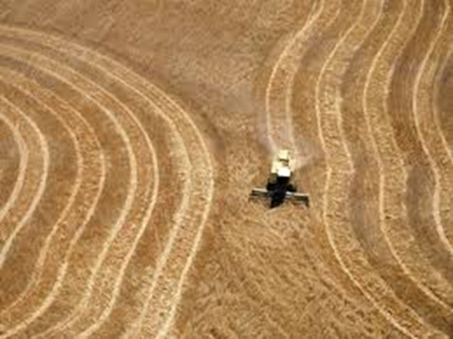
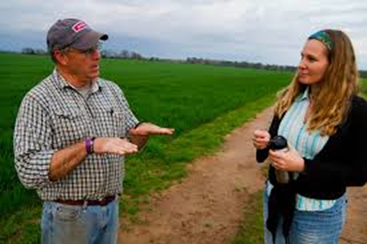
Conclusion
Healthy natural ecosystems and sustainable primary production systems are fundamental to social, environmental and economic well-being.
With more than 50 per cent of the Adelaide and Mount Lofty Ranges region used for primary production, the board will continue to partner with industry to increase sustainability in production systems.

Slide 22
Thank you for your participation

