Slide 1
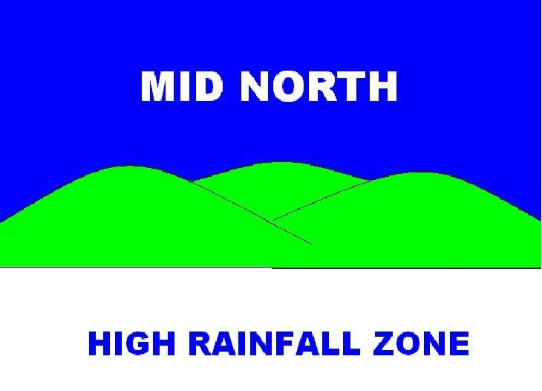
Beyond Survival…

Slide 2
MNHRZ Facts
Have been operating since 2005 (2006 officially)
Have a stable membership base (approx. 50)
Good levels of industry sponsorship
Annual presentations: Autumn (Trial Results), July (Winter walk) and Sept/Oct (Main field day)

Slide 3
What have we learnt on the journey?
Realise your place in the world or “niche”
Don’t try to achieve what you know you can’t
Don’t beat yourself up if you don’t have many “bums on seats”
Engage enthusiastic, driven people on your committee and it will thrive
Try not to become too town specific
Engage local agronomists/consultants for speaking roles at field days in conjunction with research personnel

Slide 4
What have we learnt on the journey?
Must offer members value
Collaborate with other groups to ensure survival!

Slide 5
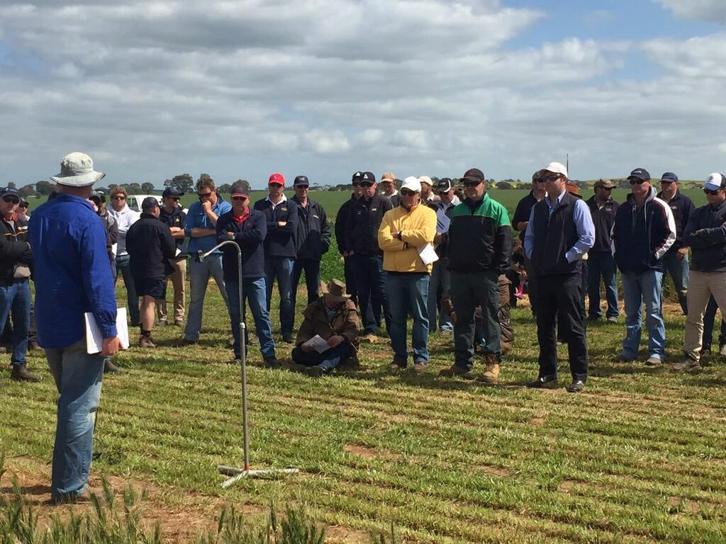
“@jeffwbraun welcomes 70+ growers to Min Dorth HRZ crop walk at Riverton. Crops look brilliant” – David Evans, Grain Growers Limited

