Slide 1
Delivering multiple benefit messages –
A partnership between the grains industry and NRM

Slide 2
Priority issue – Northern and Yorke Region
“Holistic approach to weed management –
all weeds in all years”
Don’t just focus on a few problem weeds in a few paddocks and short term solutions

Slide 3
Key messages communicated
Short term solutions in a drum is not sustainable
There are a whole range of non-chemical control measures
Always keep an eye on emerging weeds – old foes and new enemies

Slide 4
Approaches used
Relationship building - local NRM staff
Workshops – weed experts
Field days – new technology
Quality communication material

Slide 5
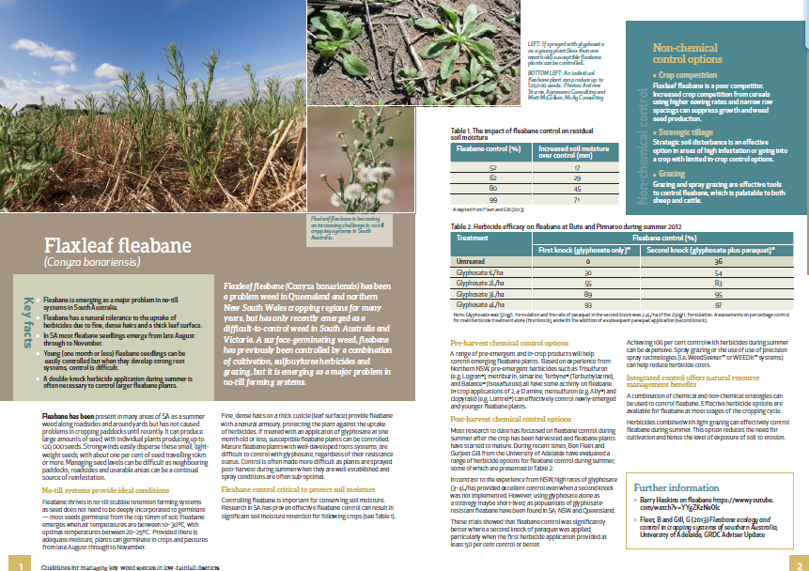

Slide 6
Looking in the rear view mirror
What’s worked
NRM relationships
Quality information delivered
What could have been done better
More consultation with FS groups at start
Get regional NRM managers onboard at start

